Slide 1

Quantitative Trading Strategy
Group 7
Toh Hui Ting, Minton Yap Li Hui, Lee Chew Ping, Jennifer Claudia Gozal, Lee Hiao Huang, Ong Kuei Hsien, Stanley Wong Hung Yee

Slide 2
Objective
Implement two broad types of trading strategy – mean reversion and momentum
Explore the performance of both strategies
Mean-reversion strategies: pairs trading strategies on HK equities
Momentum strategies: volume-based trading strategies on US equities ETF
Data sources: Bloomberg, Hong Kong Exchange (via Nasdaq Datalink), Yahoo Finance
Data period: 5 years historical – 22 May 2018 – 22 May 2023 (80-20 train-test split)
Ong Kuei Hsien

Slide 3

Pairs Trading
Pairwise correlation?
Sortino ratio?

Slide 4
Economic Justifications of pairs trading strategies Mean reverting behaviour between related stocks
Market inefficiencies: Related assets may not react on the same stimulus at the same time, resulting in transient dislocation of spread; this is expected to be corrected in the long run
Diversification: Running multiple pairs from different sectors concurrently may achieve diversification due to low correlation
Risk Management: Strive for market neutrality through pairs of long and short trade
Ong Kuei Hsien
Notes:
The reasons why pairs trading strategy work. The strategy takes advantage of the understanding that markets are inefficient more often than we know. The transient spreads between similar shares are opportunity for us to capitalise on. Cross sectors pairs are put into trade simultaneously to enjoy benefits of some extent of diversification. For example, technology stock and utility stock
Pair trading shld work also because of the risk management perspective where the strategy strives for market neutrality

Slide 5
Trading Strategy - Pipeline
Pairs Identification
ML Clustering technique
Scoring based on sector, industry, sub-industry classification
In-sample back-test
Rolling-window cointegration test
Trading signal generation (z-score, s-score)
Strategy optimization
Trade bounds, exit signals
Stop-loss
Pairs shrinkage by reducing non-winning pairs for out-sample back-test
Out-sample back-test
Performance evaluation
Data Pre-processing
Eliminate tickers with >30% missing values
Forward fill missing values
Standardization
90% Winsorization
Dynamic Time Warping
Sum of Squared Distance
Ong Kuei Hsien

Slide 6
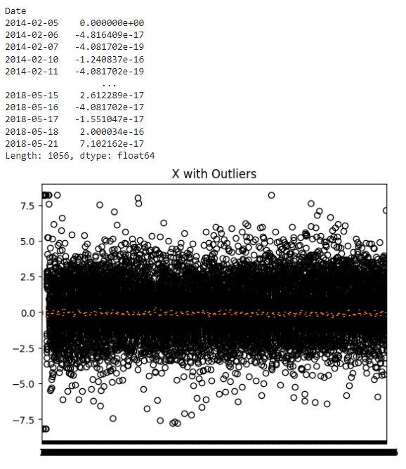
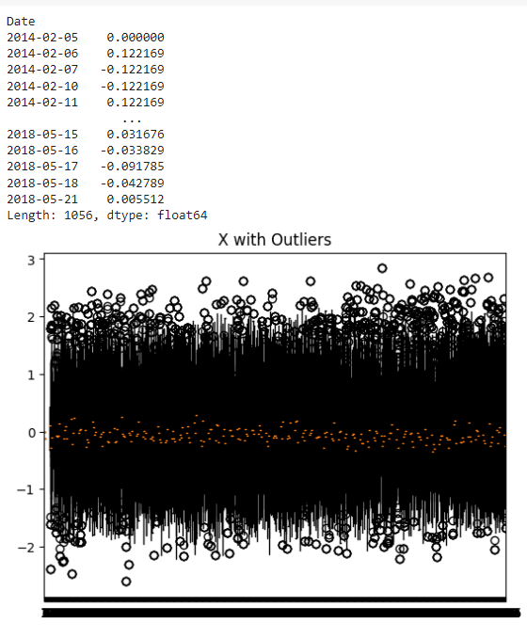
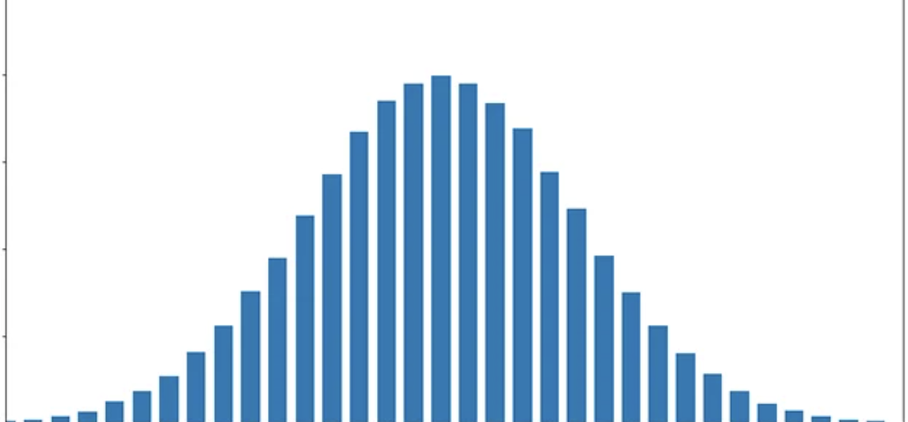
Data Pre-processing
Handling missing prices
Only trades assets that are listed on or before the training start date
Forward fill remaining missing values to account for missing values due to trading holidays
Processing for machine learning techniques
Standardization of values
Winsorization – 90% of mean
Reference:
Nakagawa, K., Imamura, M., & Yoshida, K. (2019). Stock price prediction using k‐medoids clustering with indexing dynamic time warping. Electronics and Communications in Japan, 102(2), 3-8. https://doi.org/10.1002/ecj.12140
Ong Kuei Hsien
Notes:
Avg monthly Returns: Literature reviewed Nakagawa claimed, investors tend to follow behavioral traits of > Identifying stock pattern based on monthly returns, > Monthly returns capture Seasonality well,
Common measurement of factor returns in monthly basis

Slide 7
Flow-chart of pairs identification
Dynamic Time Warping
Kmeans / Hierarchical Clustering / Affinity Propagation (Machine Learning)
Dynamic Time Warping
Stanley

Slide 8
Dynamic Time Warping
Package Used: Implemented DtwParallel python package (Escudero Arnanz et. al. (2023))
Why DTW?
Manage varying time series length, speed, and distortions
DTW warps time sequence to enhance alignment
Allows DTW to compare intricate distance that are out of phase or different in length time
Superior method to Euclidean distance but computationally expensive
Implementation
Set "Sakoe Chiba" global constraint to lower computational cost (known for lower error rate)
DTW => Clustering Algorithm => DTW
Reference:
Escudero Arnanz, O., G Marques, A., Soguero-Ruiz, C., Mora-Jiménez, I., & Robles, G.(2023) Dtwparallel: A Python Package to Efficiently Compute Dynamic Time Warping. Original Software Publication, Software X. Volume 22, 101364. https://doi.org/10.1016/j.softx.2023.101364
Nakagawa, K., Imamura, M., & Yoshida, K. (2019). Stock price prediction using k‐medoids clustering with indexing dynamic time warping. Electronics and Communications in Japan, 102(2), 3-8.
Geler, Z., Kurbalija, V., Ivanović, M., & Radovanović, M. (2022). Elastic distances for time-series classification: Itakura versus Sakoe-Chiba constraints. Knowledge and Information Systems, 64(10), 2797-2832.
Stanley

Slide 9

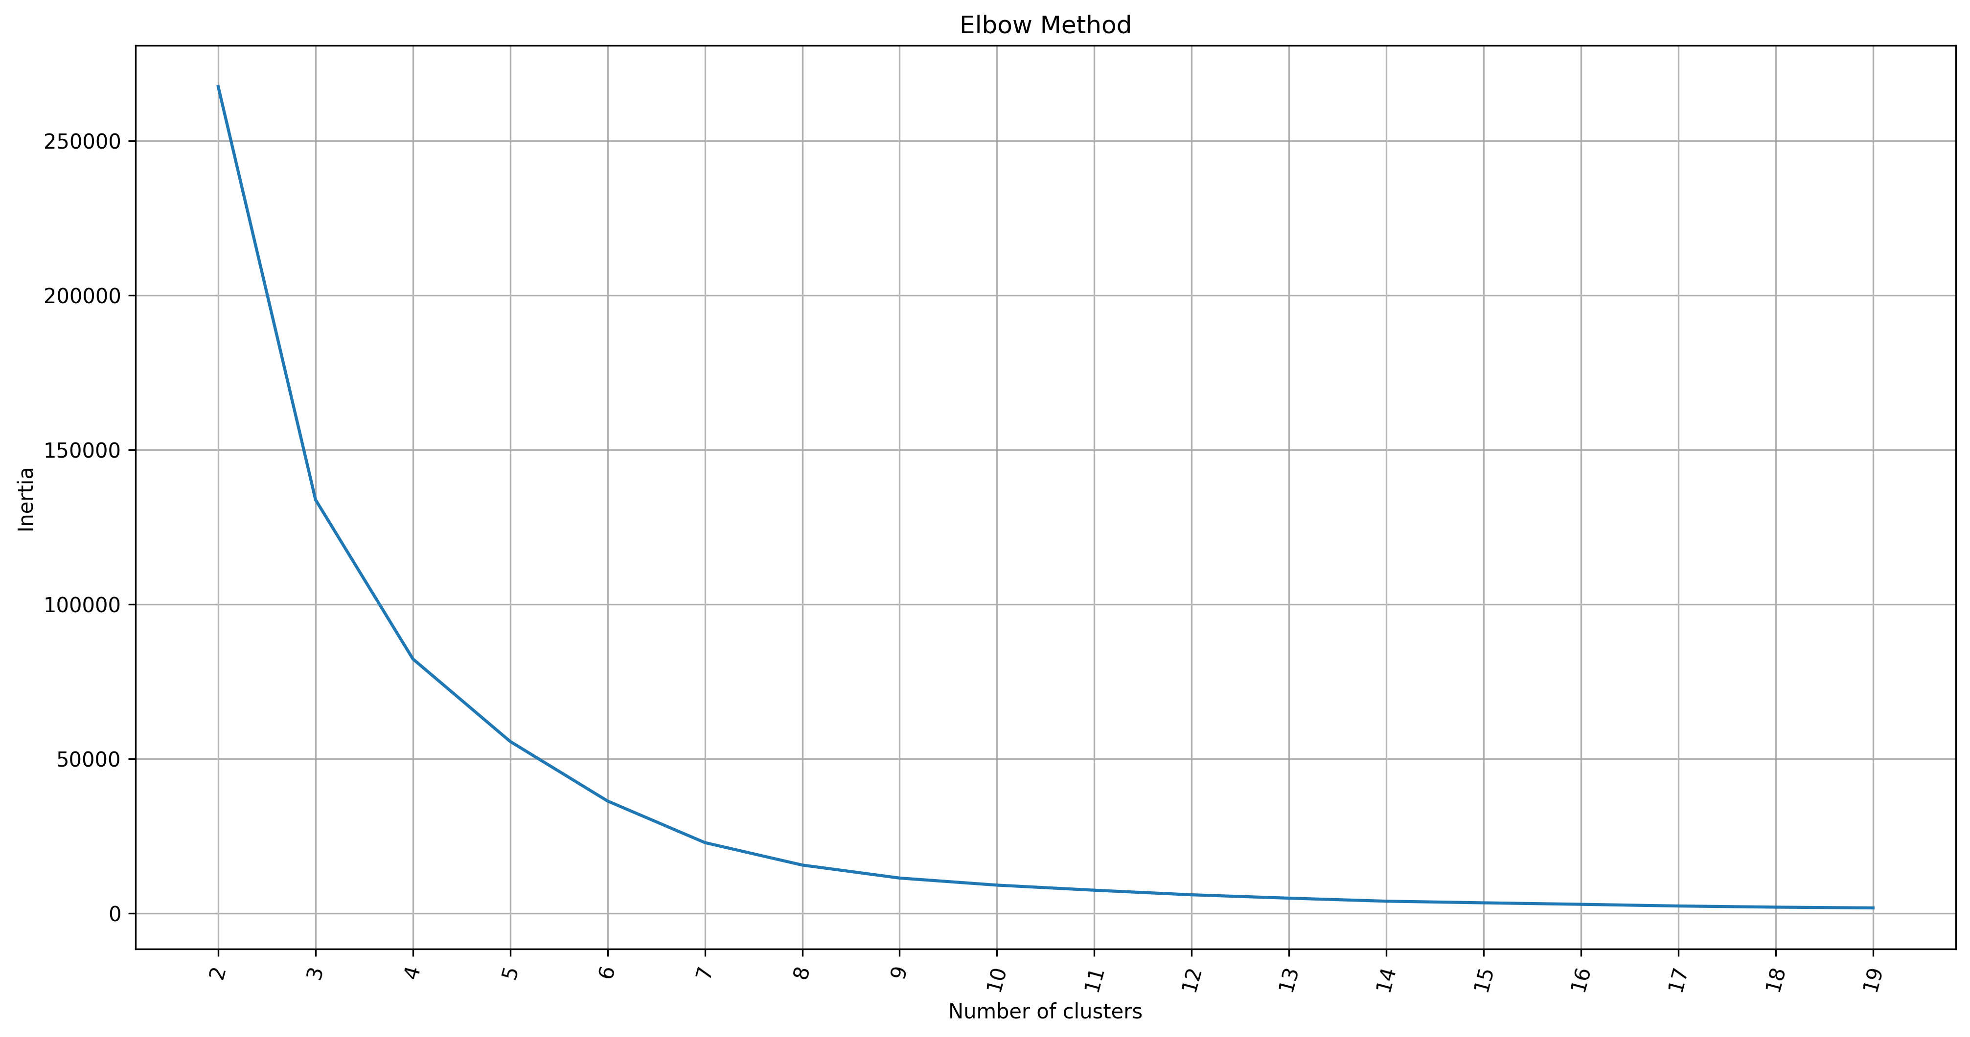
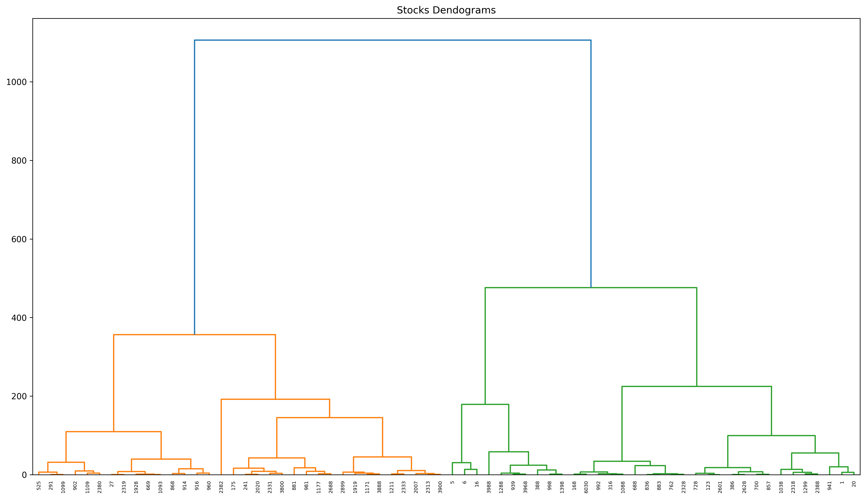
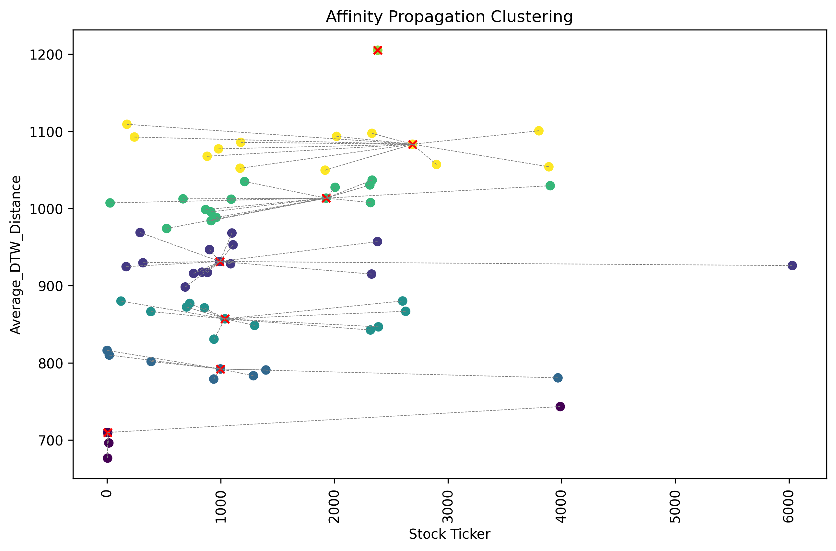
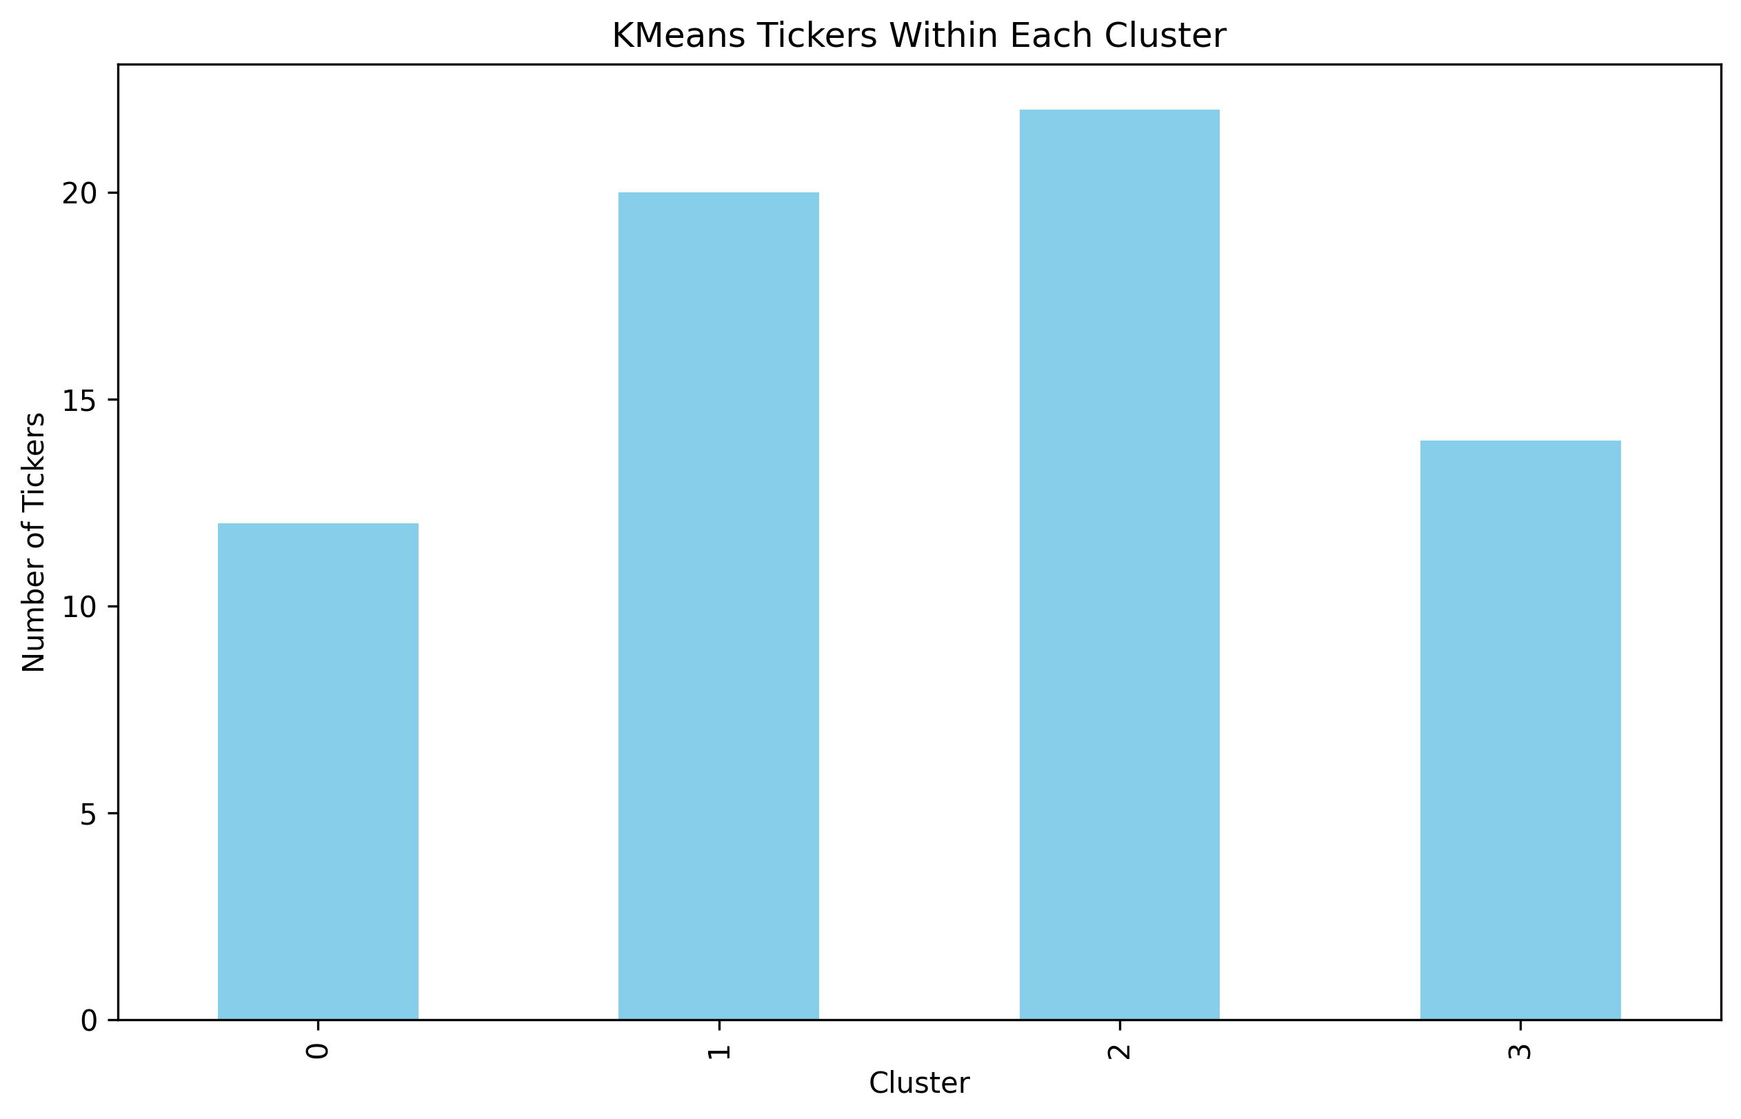
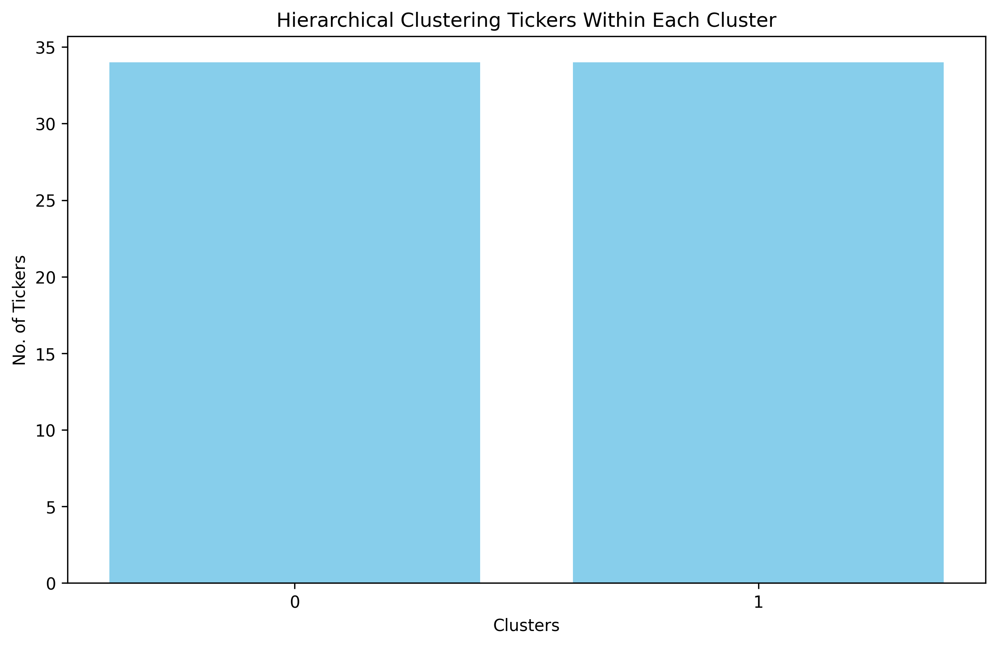
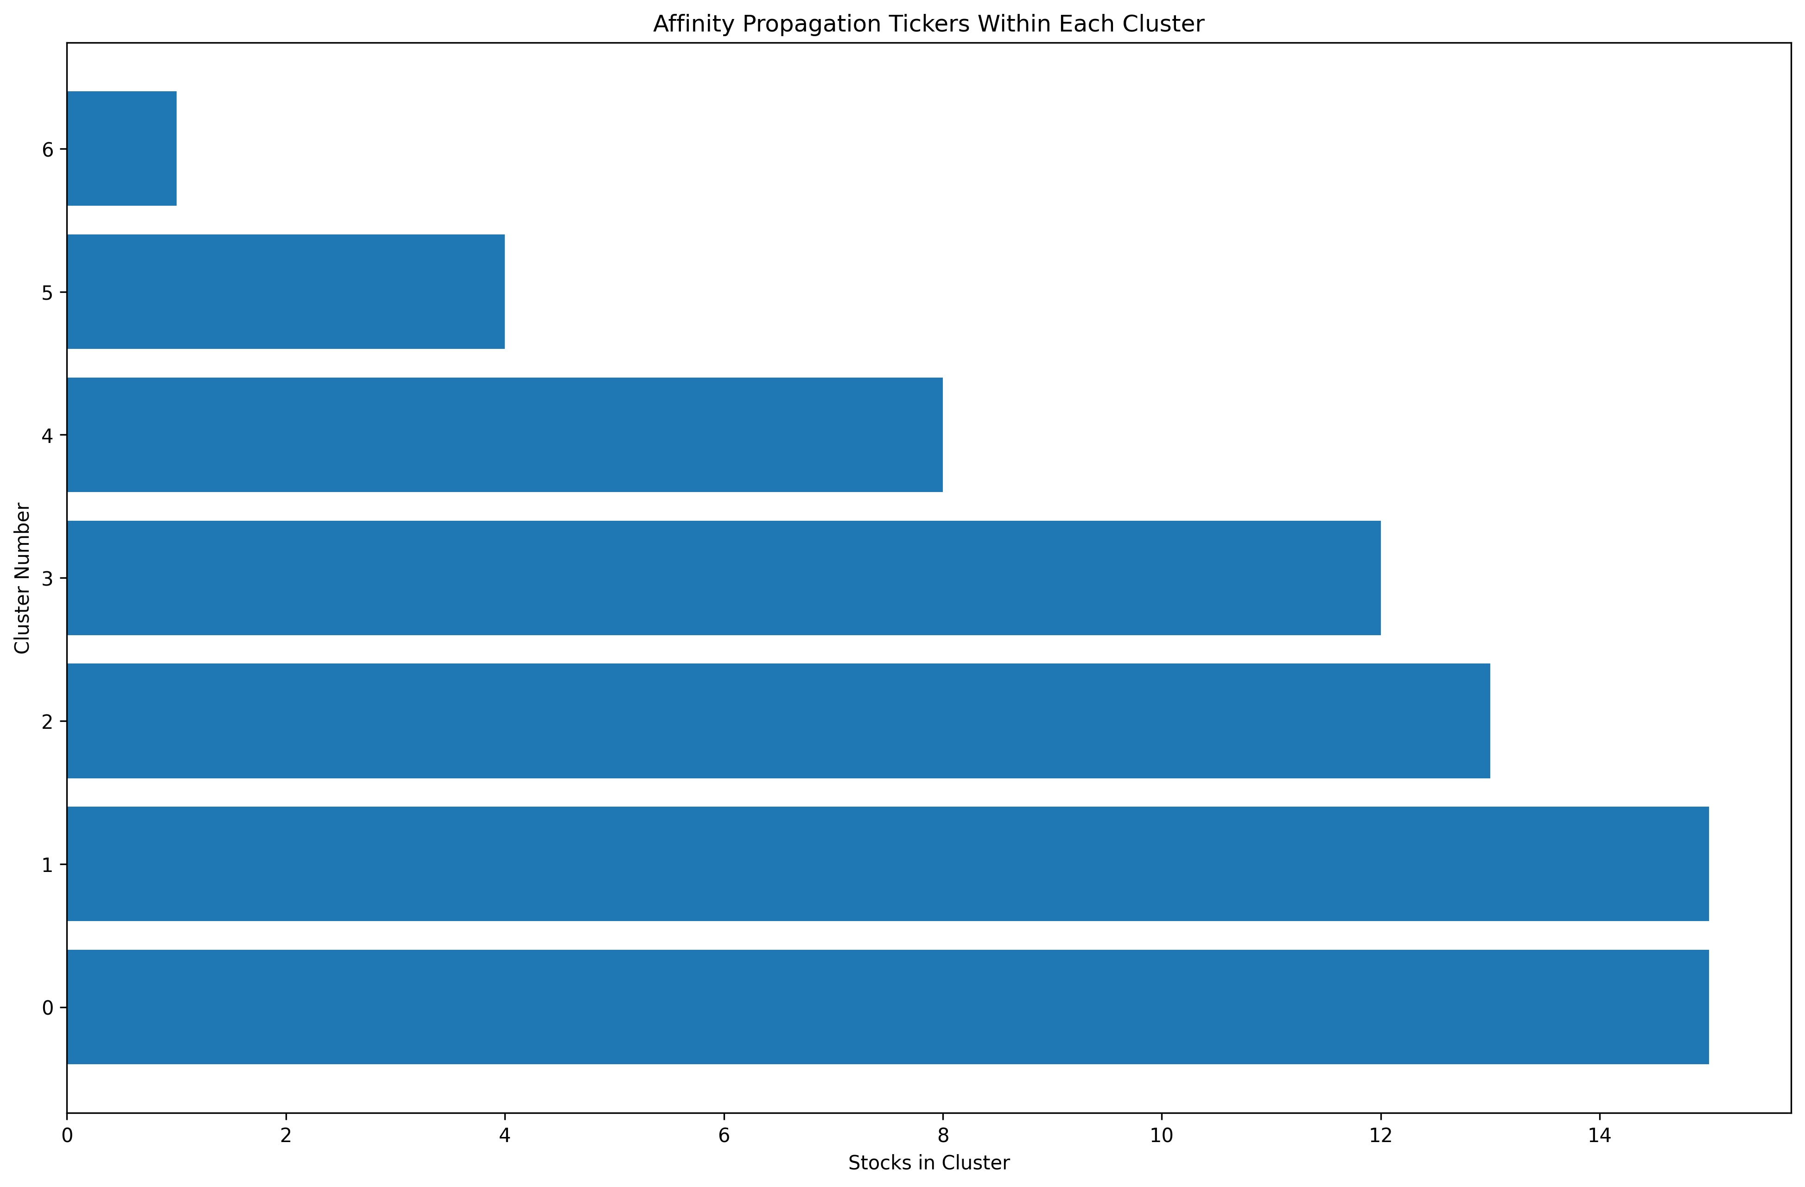
Clustering Algorithms
K Means
Hierarchical Clustering
Affinity Propagation
(4 clusters of 12, 20, 22, 14 Tickers)
(2 clusters of 34, 34 tickers)
(6 clusters of 4, 15, 8, 12, 15, 1, 13 tickers)

Slide 10
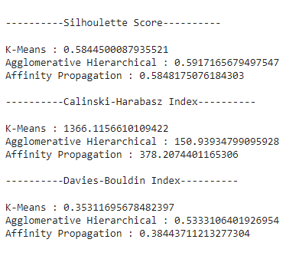
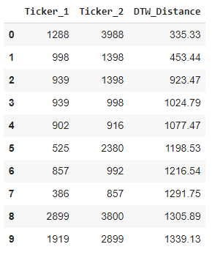
Clustering Score Metrics
K Means algorithm performs well in Calinski Harabasz and Davies Bouldin index but did worse in Silhouette Score than Agglomerative Clustering and Affinity Propagation, albeit all three models have similar score
K-Means showed consistent performance across all three performance metrics
K-Means cluster stocks will be best technique to perform clustering
Stanley

Slide 11
Sector Scoring
Sector scoring ensures that selected pairs have fundamental similarities
Assess the sector, industry and sub-industry classifications using data from Bloomberg. With each similarity, 1 score is added to the pair.
Pairs that are common across all three classifications will have a max score of 3. These are the pairs that are selected for the trading strategies.
Results: 38 pairs have been identified with DTW distance less than 100,000
Jennifer
Notes:
So after we have gotten our pairs from DTW, clustering and another DTW layer, we will do another test to further check the credibility of our pairs
So what we will do is to do sector scoring to ensure that selected pairs actually have some degree of fundamental similarities
So we begin with 578 pairs which is shortlisted from DTW
The way that we do it is by assessing the sector, industry, and sub industry classifications using data from Bloomberg.
With each similarity, 1 score is added to the pair
Pairs that are common across all 3 classification will have a maximum score of 3, and these pairs will be selected for the trading strategy
All in all, after we apply the sector scoring, we have 38 pairs identified with DTW distance less than 100,000 which will be used in the trading strategy.

Slide 12
Trading Strategy
T+0: Cointegration test
Trading window
T+20: Cointegration test
Run first cointegration test on the pairs to check for stationarity
Use past 100 days price series
Significance level = 5%
Only pairs that met the criterion can be traded
Trading signals generated based on ‘z’ or ‘s’ score
Exit signals can be symmetrical or vary with long and short position
Run second cointegration test on all pairs to check for stationarity
If an existing pair failed the test, this implies pair-breakage, position to be closed
Act as natural ‘time-based’ stop-loss
Process repeats
Jennifer
Notes:
So this is how our trading strategy look like
At time T = 0 We start by running the cointegration test on the pairs to check for the stationarity.
We assess the cointegration using the past 100 days price series, and setting the significance level to 5%
only pairs that has p value lower than the significance level will be traded
Next, we will generate trading signals based on 2 method. Using z score based signal and s score based signal

Slide 13

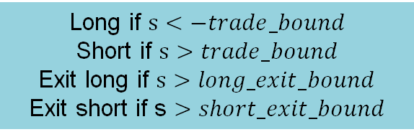
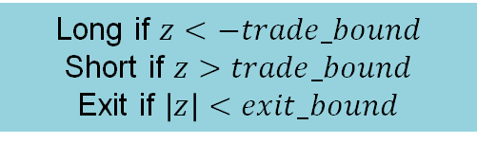

Trading Signals
2
1
Z-score based signals
$${spread}_{t}=X_{2,t}−βX_{1,t}$$
$$z=\frac{spread_{t}−{\overline{spread}}_{60ma}}{σ(Spread_{60ma})}$$
S-score based signals
Modelling the spread as an Orstein-Uhlenbeck Process
If speed of mean-reversion is greater than 8.4, there is a strong mean-reverting strength, implying short-term mean reversion tendencies. Then we calculate the s-score.
$$s=\frac{spread_{t}−m}{σ_{equilibirum}}$$
Long if $s<−trade_bound$
Short if $s>trade_bound$
Exit long if $s>long_exit_bound$
Exit short if s $>short_exit_bound$
Long if $z<−trade_bound$
Short if $z>trade_bound$
Exit if $\left|z\right|<exit_bound$
Trade bound = 1.4
Exit bound = 1
Trade bound = 0.8
Long Exit bound = -0.4
Short Exit bound = 0.6
Marco Avellaneda & Jeong-Hyun Lee (2010) Statistical arbitrage in the US
equities market, Quantitative Finance, 10:7, 761-782, DOI: 10.1080/14697680903124632
Jennifer
Notes:
For Z score based signal
We calculate the z score by minusing the spread with the 60 days moving average spread, and dividing it with the standard deviation
If the zscore drops below -1.4, we buy 1 dollar worth of stock 2 and short beta dollar of stock 1
If the zscore moves above 1.4, we short 1 dollar worth of stock 2 and buy beta dollar of stock 1
For either trades, the zscore goes to below 1/-1 we will close the positions, because it means that the pair is already returning to its long term equilibrium
The second one is the s score based signal, in which we are modelling the spread as an Orstein Uhlenbeck process
Ornstein uhlenbeck process is a stochastic process that is widely used in finance to model the behavior of a system that shows mean-reverting properties
first calculate the the mean reversion speed.
If the mean reversion speed is greater than 8.4, it shows that it has a strong mean reversion strength and implies that there is a strong tendency of mean reversion in the near future.
For the pairs that have a mean reversion greater than 8.4. we will calculate the s-score with this formula
To enter the trade, we will use the similar way like the z score based signals, with just a different trade bound value
However to exit the trade, we will use different bounds to exit the long trades vs short trades
The idea is to hold into the long position longer than the short position
We exit the long trade when the s score is greater than -0.4
And we exit the short trade when the s score is greater than 0.6
a, b = sm.OLS(Y2, sm.add_constant(X2)).fit().params
kappa = -np.log(b) * 252
m = a / (1-b)
sigma = np.sqrt(np.var(zeta)*2*kappa/(1 - np.square(b)))
sigma_eq = np.sqrt(np.var(zeta)/(1 - np.square(b)))
The process is a continuous-time analog of the discrete time autoregressive process
It is a stationary stochastic process that describes the motion of a particle undergoing random fluctuations subject to a force that pulls it back towards a central value or mean
For the s score based signals, the exit signals will vary with long or short position. so that we will be holding to the long position longer than holding the short position
If the sscore drops below -0.8, we buy 1 dollar worth of stock 2 and short beta dollar of stock 1
If the sscore moves above 0.8, we short 1 dollar worth of stock 2 and buy beta dollar of stock 1

Slide 14
Trading Strategy
T+0: Cointegration test
Trading window
T+20: Cointegration test
Run first cointegration test on the pairs to check for stationarity
Use past 100 days price series
Significance level = 5%
Only pairs that met the criterion can be traded
Trading signals generated based on ‘z’ or ‘s’ score
Exit signals can be symmetrical or vary with long and short position
Run second cointegration test on all pairs to check for stationarity
If an existing pair failed the test, this implies pair-breakage, position to be closed
Act as natural ‘time-based’ stop-loss
Process repeats
Jennifer
Notes:
At time T+20, we will run a second cointegration test on all the pairs to check for the stationarity again
This is to ensure that with new monthly data, the pairs are actually still cointegrated
If an existing pair falied the test, this implies pairs breakage, and the position will be closed, and this will act as a natural time based stop loss

Slide 15
Illustration: Pairs trading lifecycle
20D trading window
20D trading window
P1
Cointegration test #1
pass
Cointegration test #2
fail
fail
P2
pass
pass
fail
P3
fail
pass
pass
P4
pass
fail
fail
P38
fail
pass
pass
Jennifer
Notes:
As an illustration:
On T=0 we perform cointegration test on all 38 pairs, and let say pair 1 2 and 4 pass the test.
It will be traded for 20 days before being tested for cointegration again
For the 1st & 4th pair, it will be removed from the trading universe because it failed
The 2nd pair will keep being traded
The 3rd pair will be included in the trading universe this time, although it was not traded before

Slide 16
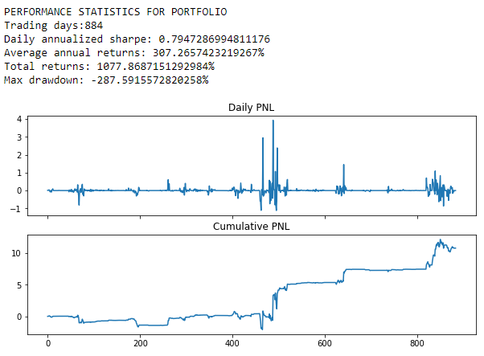
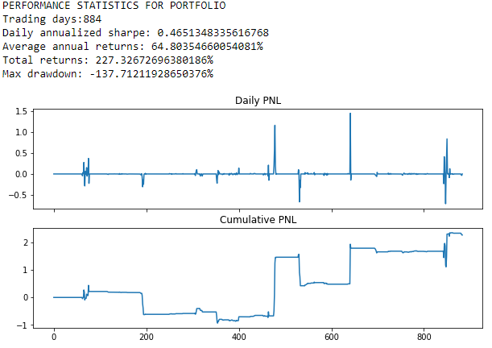
In-sample test results
Z-score based trading strategy
S-score based trading strategy
Chew Peng

Slide 17
Strategy Optimization
Some optimization of the trading strategies include tuning the trade bounds, exit bounds, trading window, number of datapoint for cointegration tests.
After the optimization, the following parameters are used:
Z-score: (trade_bound = 1.4, exit_bound = 1.0, window = 20, look_back = 100)
S-score: (trade_bound = 0.8, exit_bound = (-0.40, 0.60), window = 20, look_back = 100)
Once the optimization has been completed, we run in-sample test again. Here, we will exclude pairs that performed poorly, i.e. achieved negative Sharpe ratio.
The idea is that if the pairs failed to perform during in-sample testing, the likelihood that these pairs will perform in out-sample test will be low.
Chew Peng

Slide 18
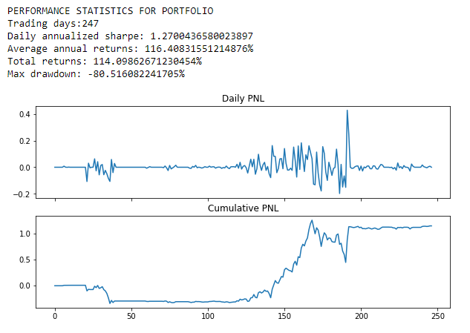
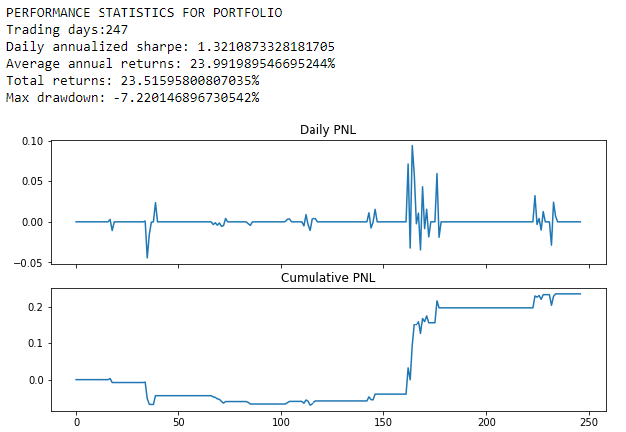
Out-sample test results
Z-score based trading strategy
S-score based trading strategy
Chew Peng

Slide 19
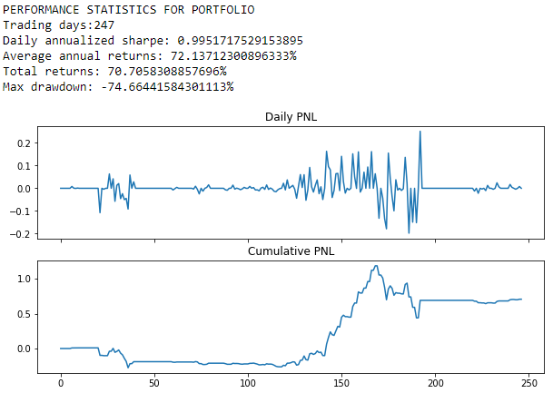
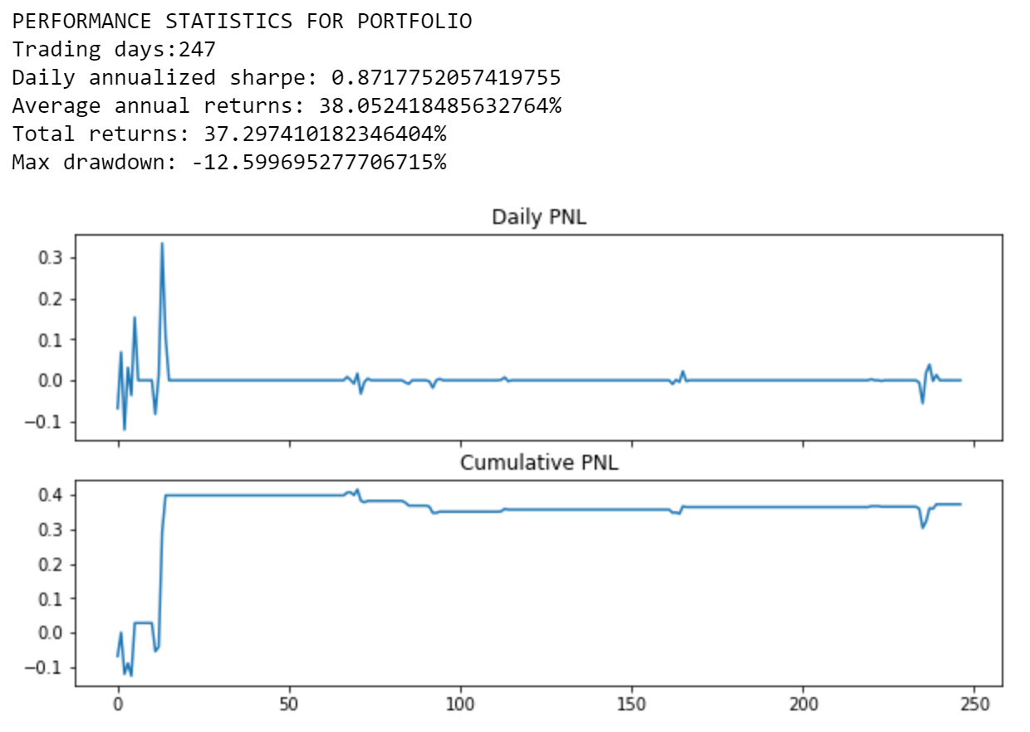
Further analysis
Z-score based strategy (stop-loss = +/-1.9)
S-score based strategy (stop-loss = +/-1.6)
Chew Peng

Slide 20
Further Analysis – summary of Out-sample test
 | Z-score strategy |  |  | S-score strategy
 | Sharpe Ratio | MDD (%) | Annualized return (%) | Sharpe Ratio | MDD (%) | Annualized return (%)
Without stop loss | 1.27 | 81 | 116 | 1.32 | 7.22 | 24
With stop loss | 0.99 | 75 | 72 | 0.87 | 12.6 | 38
With stop loss + trxn cost (30 bps) | 0.46 | 77 | 32 | 0.58 | 14.1 | 25
Chew Peng

Slide 21
Challenges encountered and overcame
Due to computational time constraint, static window for cointegration test was used which led to poor detection of pair breakage. Also led to wrong trades being placed right before pair breakages.
S-score – using s-score as signals can be difficult as it needs to meet conditions: 1) speed of mean reversion must be fast enough, 2) trade bounds must be met; this led to much lesser trades
Data-sorting and classification
Difficulty at identifying pairs with positive sharpe ratio
Stop-loss (based on PnL & drawdown) – Most of our strategies faced huge negative pnl before going into positive. Max Drawdown is also high. Stop-losses implemented cannot effectively manage drawdowns as such.
On hindsight, we should have heed to the Principle of Parsimony and kept model simple.
Hui Ting

Slide 22
Areas of Improvement
Survivor bias
Handling of missing values
Inclusion of transaction cost
Inclusion of market impact
Apply effective stop-losses
Implement capital allocation
Hui Ting

